Slide 2
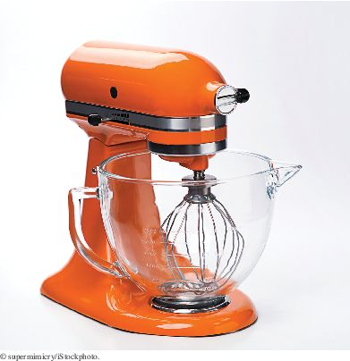
Chapter Goals
To be able to declare and use interface types
To appreciate how interfaces can be used to decouple classes

Slide 3

Using Interfaces for Algorithm Reuse
Interface types are used to express common operations.
Interfaces make it possible to make a service available to a wide set.
This restaurant is willing to serve anyone who conforms to the Customer interface with eat and pay methods.

Slide 4
Defining an Interface Type
Example: a method to compute the average of an array of Objects
The algorithm for computing the average is the same in all cases
Details of measurement differ
Goal: write one method that provides this service.
We can't call getBalance in one case and getArea in another.
Solution: all object who want this service must agree on a getMeasure method
BankAccount's getMeasure will return the balance
Country's getMeasure will return the area
Now we implement a single average method that computes the sum:
sum = sum + obj.getMeasure();

Slide 5
Defining an Interface Type
Problem: we need to declare a type for obj
Need to invent a new type that describes any class whose objects can be measured.
An interface type is used to specify required operations (like getMeasure):
public interface Measurable
{
double getMeasure();
}
A Java interface type declares methods but does not provide their implementations.

Slide 6
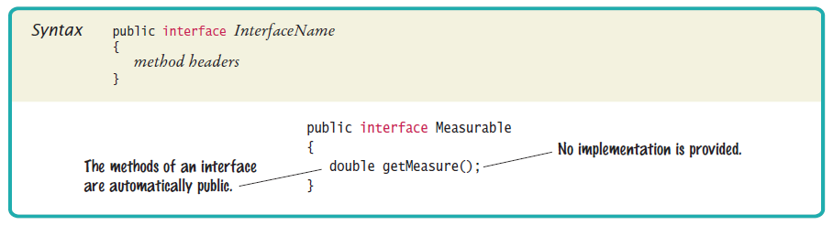
Syntax 10.1 Declaring an Interface

Slide 7
Defining an Interface Type
An interface type is similar to a class.
Differences between classes and interfaces:
An interface type does not have instance variables.
All methods in an interface type are abstract
They have a name, parameters, and a return type, but no implementation.
All methods in an interface type are automatically public.
An interface type has no constructor.
You cannot construct objects of an interface type.

Slide 8
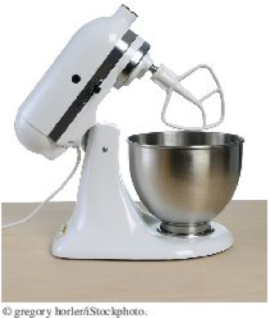
Defining an Interface Type
Implementing a reusable average method:
public static double average(Measurable[] objects)
{
double sum = 0;
for (Measurable obj : objects)
{
sum = sum + obj.getMeasure();
}
if (objects.length > 0) { return sum / objects.length; }
else { return 0; }
}
This method is can be used for objects of any class that conforms to the Measurable type.

Slide 9
Implementing an Interface Type
Use implements reserved word to indicate that a class implements an interface type:
public class BankAccount implements Measurable
{
…
public double getMeasure()
{
return balance;
}
}
BankAccount objects are instances of the Measurable type:
Measurable obj = new BankAccount(); // OK

Slide 10
Implementing an Interface Type
A variable of type Measurable holds a reference to an object of some class that implements the Measurable interface.
Country class can also implement the Measurable interface:
public class Country implements Measurable
{
public double getMeasure()
{
return area;
}
. . .
}
Use interface types to make code more reusable.

Slide 11
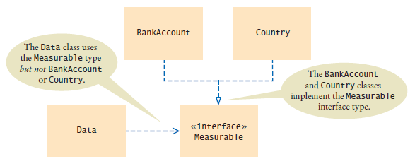
Implementing an Interface Type
Put the average method in a class - say Data
Figure 1 UML Diagram of the Data Class and the Classes that Implement the Measurable Interface
Data class is decoupled from the BankAccount and Country classes.

Slide 12
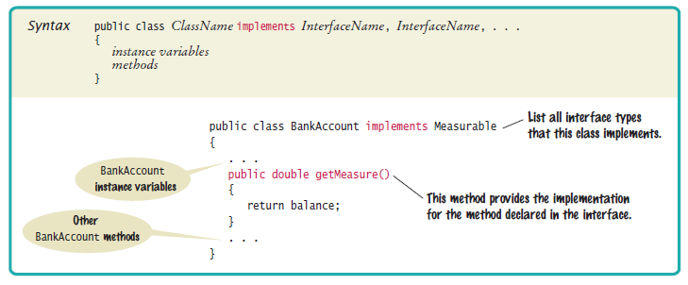
Syntax 10.2 Implementing an Interface

Slide 13
section_1/Data.java
1 public class Data
2 {
3 /**
4 Computes the average of the measures of the given objects.
5 @param objects an array of Measurable objects
6 @return the average of the measures
7 */
8 public static double average(Measurable[] objects)
9 {
10 double sum = 0;
11 for (Measurable obj : objects)
12 {
13 sum = sum + obj.getMeasure();
14 }
15 if (objects.length > 0) { return sum / objects.length; }
16 else { return 0; }
17 }
18 }

Slide 14
section_1/MeasurableTester.java
1 /**
2 This program demonstrates the measurable BankAccount and Country classes.
3 */
4 public class MeasurableTester
5 {
6 public static void main(String[] args)
7 {
8 Measurable[] accounts = new Measurable[3];
9 accounts[0] = new BankAccount(0);
10 accounts[1] = new BankAccount(10000);
11 accounts[2] = new BankAccount(2000);
12
13 double averageBalance = Data.average(accounts);
14 System.out.println("Average balance: " + averageBalance);
15 System.out.println("Expected: 4000");
16
17 Measurable[] countries = new Measurable[3];
18 countries[0] = new Country("Uruguay", 176220);
19 countries[1] = new Country("Thailand", 513120);
20 countries[2] = new Country("Belgium", 30510);
21
22 double averageArea = Data.average(countries);
23 System.out.println("Average area: " + averageArea);
24 System.out.println("Expected: 239950");
25 }
26 }
Continued

Slide 15
section_1/MeasurableTester.java
Program Run:
Average balance: 4000
Expected: 4000
Average area: 239950
Expected: 239950

Slide 16
Comparing Interfaces and Inheritance
Here is a different interface: Named
public interface Named
{
String getName();
}
A class can implement more than one interface:
public class Country implements Measurable, Named
A class can only extend (inherit from) a single superclass.
An interface specifies the behavior that an implementing class should supply - no implementation.
A superclass provides some implementation that a subclass inherits.
Develop interfaces when you have code that processes objects of different classes in a common way.

Slide 17
Converting From Classes to Interfaces
You can convert from a class type to an interface type, provided the class implements the interface.
A Measurable variable can refer to an object of the BankAccount class because BankAccount implements the Measurable interface:
BankAccount account = new BankAccount(1000);
Measurable meas = account; // OK
A Measurable variable can refer to an object of the Country class because that class also implements the Measurable interface:
Country uruguay = new Country("Uruguay", 176220);
Measurable meas = uruguay; // Also OK // Also OK

Slide 18
Converting From Classes to Interfaces
A Measurable variable cannot refer to an object of the Rectangle class because Rectangle doesn't implement Measurable:
Measurable meas = new Rectangle(5, 10, 20, 30); // ERROR

Slide 19
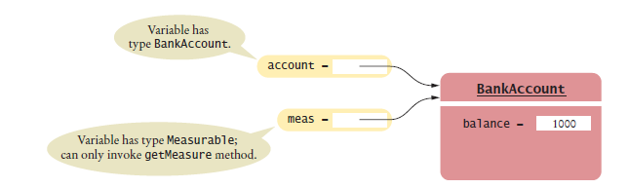
Variables of Class and Interface Types
Figure 2 Two references to the same object

Slide 20
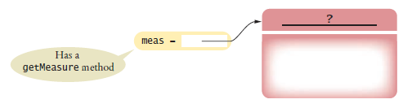
Variables of Class and Interface Types
Figure 3 An Interface Reference Can Refer to an Object of Any Class that Implements the Interface
Method calls on an interface reference are polymorphic. The appropriate method is determined at run time.

Slide 21
Casting from Interfaces to Classes
Method to return the object with the largest measure:
public static Measurable larger(Measurable obj1,
Measurable obj)
{
if (obj1.getMeasure() > obj2.getMeasure())
{
return obj1;
}
else
{
return obj2;
}
}
Returns the object with the larger measure, as a Measurable reference.
Country uruguay = new Country("Uruguay", 176220);
Country thailand = new Country("Thailand", 513120);
Measurable max = larger(uruguay, thailand);

Slide 22

Casting from Interfaces to Classes
You know that max refers to a Country object, but the compiler does not.
Solution: cast
Country maxCountry = (Country) max;
String name = maxCountry.getName();
You need a cast to convert from an interface type to a class type.
If you are wrong and max doesn't refer to a Country object, the program throws an exception at runtime.
If a Person object is actually a Superhero, you need a cast before you can apply any Superhero methods.

Slide 23
The Comparable Interface
Comparable interface is in the standard Java library.
Comparable interface has a single method:
public interface Comparable
{
int compareTo(Object otherObject);
}
The call to the method:
a.compareTo(b)
The compareTo method returns:
a negative number if a should come before b,
zero if a and b are the same
a positive number if b should come before a.
Implement the Comparable interface so that objects of your class can be compared, for example, in a sort method.

Slide 24
The Comparable Interface
BankAccount class' implementation of Comparable:
public class BankAccount implements Comparable
{
. . .
public int compareTo(Object otherObject)
{
BankAccount other = (BankAccount) otherObject;
if (balance < other.balance) { return -1; }
if (balance > other.balance) { return 1; }
return 0;
}
. . .
}
compareTo method has a parameter of reference type Object
To get a BankAccount reference:
BankAccount other = (BankAccount) otherObject;

Slide 25

The Comparable Interface
Because the BankAccount class implements the Comparable interface, you can sort an array of bank accounts with the Arrays.sort method:
BankAccount[] accounts = new BankAccount[3];
accounts[0] = new BankAccount(10000);
accounts[1] = new BankAccount(0);
accounts[2] = new BankAccount(2000);
Arrays.sort(accounts);
Now the accounts array is sorted by increasing balance.
The compareTo method checks whether another object is larger or smaller.

